Slide 1
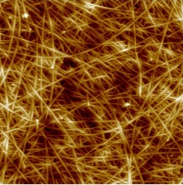
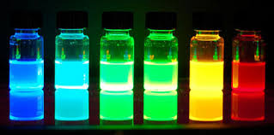
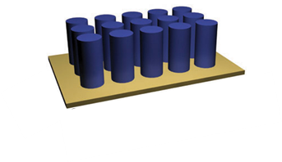
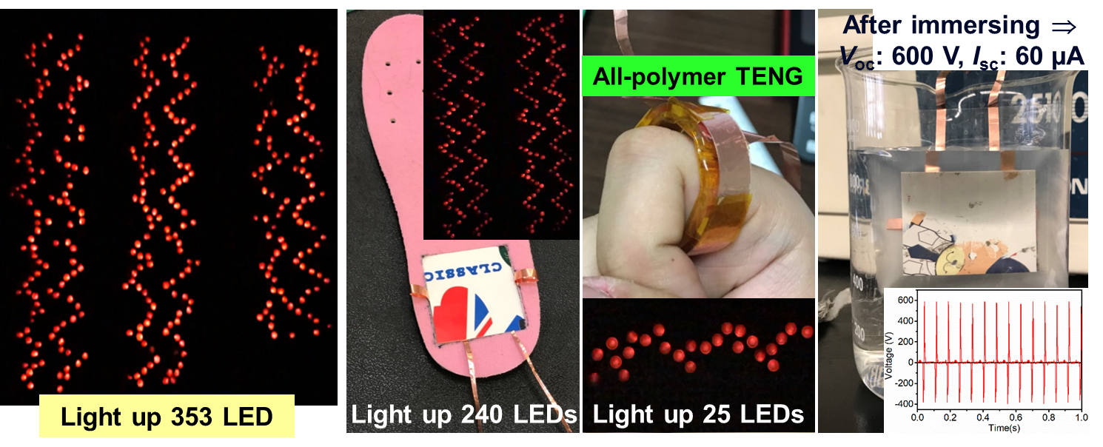
Flexible Optoelectronic Materials & Devices Lab
Surface Chemistry & Functionalization
Atomic Layer Deposition
Molecular Layer Deposition
Self-Assembly Monolayer
Interfacial Engineering
Functional Thin Films
Interfacial Properties
Work-Function Modulation
Low-Dimensional
Nanomaterials
Nanoparticles
Nanowires/Nanorods
Layered Nanomaterials
Flexible Optoelectronic
Materials & Devices
Organic Solar Cells
Hybrid Perovskite Solar Cells
Next-Generation Photosensors
Biosensing Devices & System
Wearable Self-Powered Device
Implantable Bioelectronics
Chih-Yu Chang
Associate Professor
Dept. of Materials Sci. and Eng.
Tel: +886-2-2737-6536
E-mail: cychang@mail.ntust.edu.tw
Education:
PhD. of Materials Sci. and Eng.,
National Taiwan University
Lectures:
Chemistry (I)
Organic Optoelectronic Materials
Vacuum Technology & Application
Flexible Optoelectronic Materials

