Slide 1
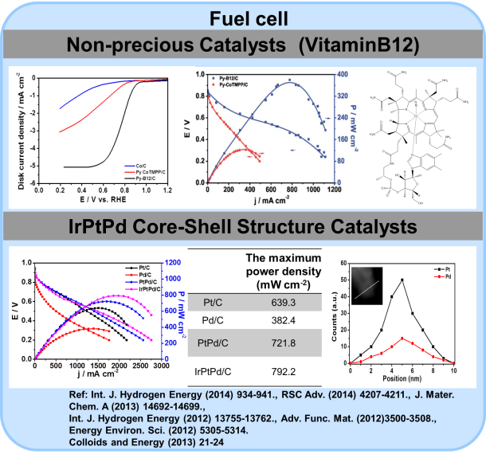
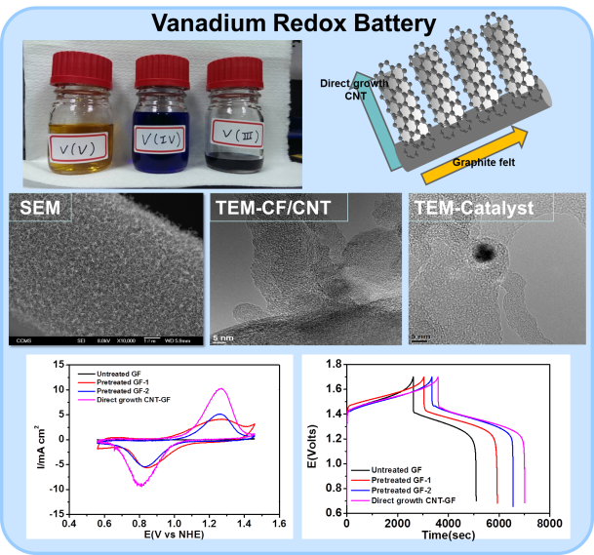
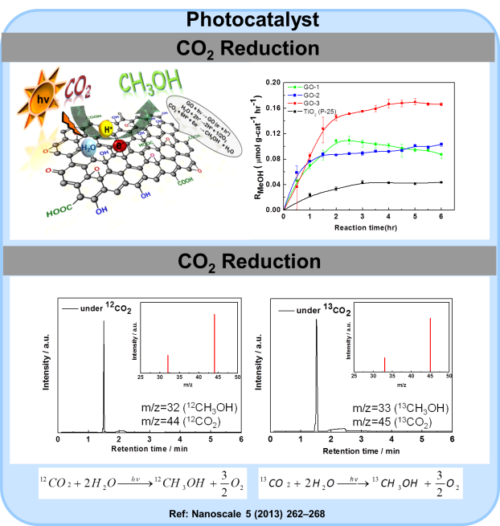
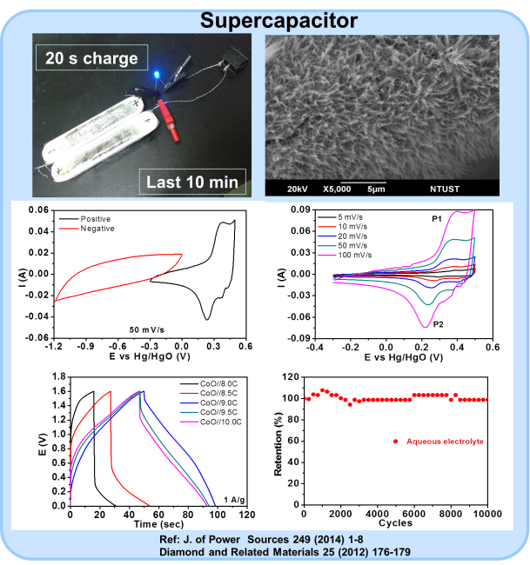
Chen-Hao Wang Ph.D.
Professor
Department of Materials
Science and Engineering
Tel:+886-2-27303715
chwang@mail.ntust.edu.tw
Energy Materials Laboratory
Education:
Ph.D. in MSE, National Tsing Hua University
Ms. In Ch.E., National Taiwan University
Bs. In Ch.E., National Taiwan University
Research Interests:
Electrochemical conversion and storage
Fuel cell
Vanadium Redox Battery
Supercapacitor
Photocatalvst
Nanotechnology
Carbon nanomaterials
1D and 2D nanomaterials
Nanocomposites

